Slide 1


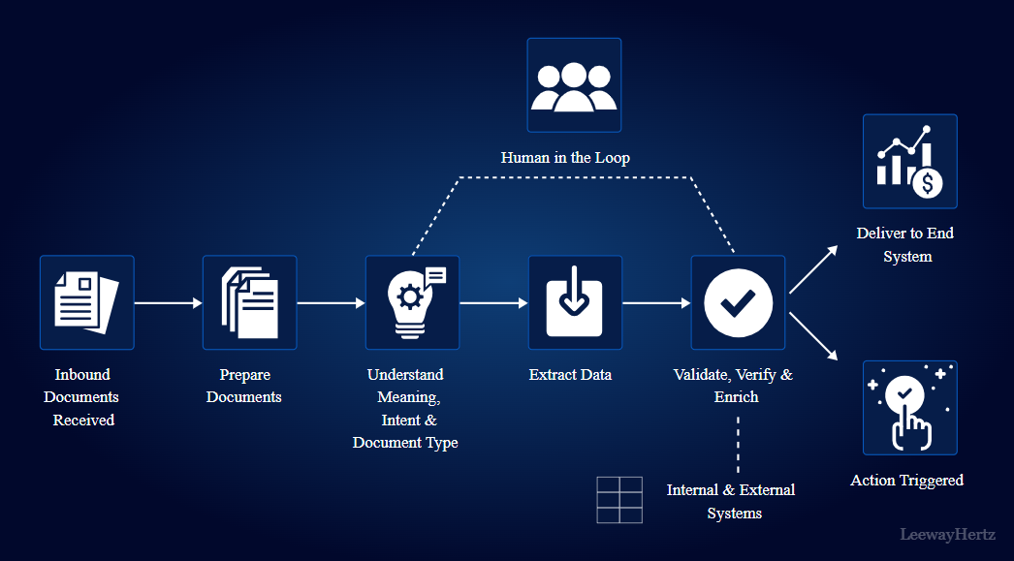

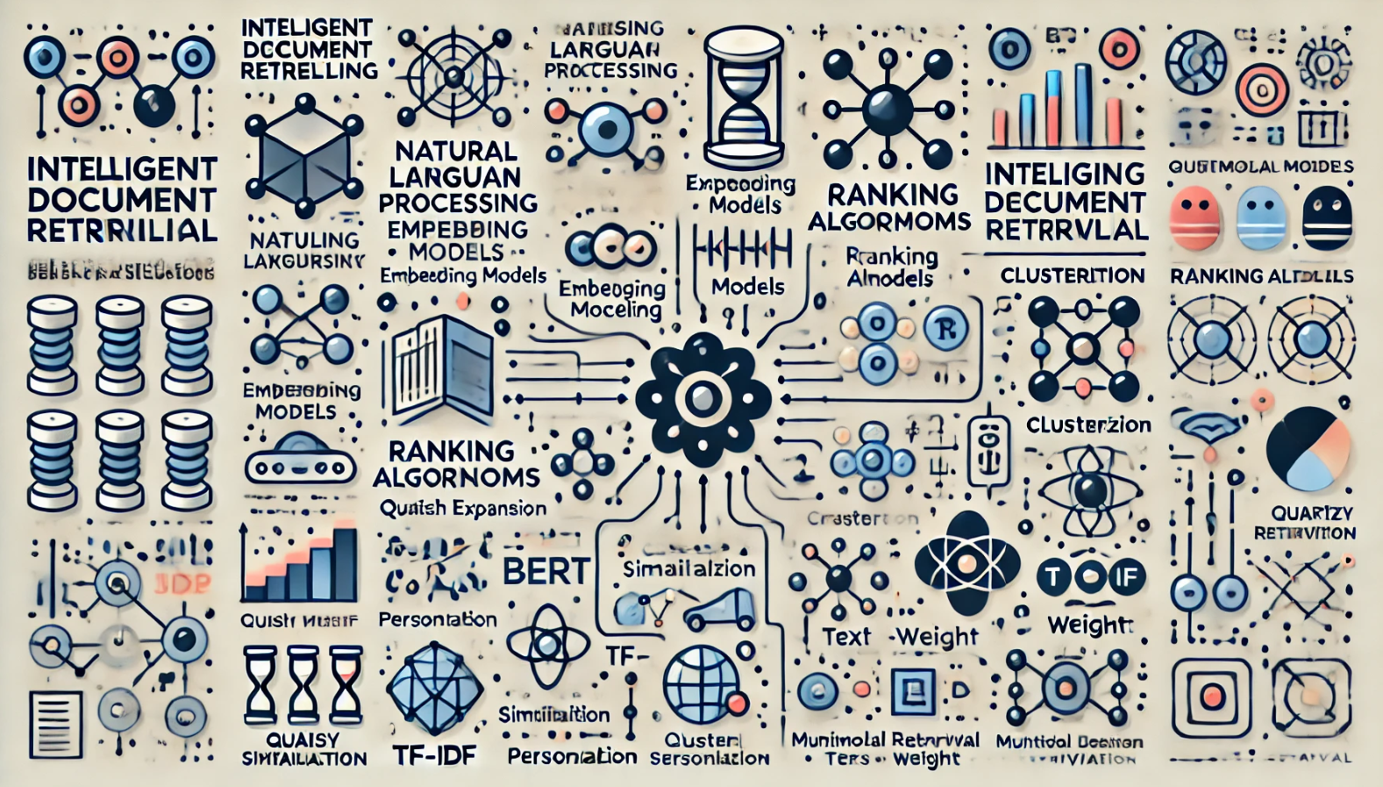
INTELLIGENT DOCUMENT RETRIEVAL
Introduction
Key Components
Future Applications
Intelligent Document Retrieval (IDR) is an advanced approach to finding and accessing relevant documents within large collections of unstructured or semi-structured data. Unlike traditional search systems that rely on basic keyword matching, IDR leverages artificial intelligence, natural language processing (NLP), and machine learning to understand the context and intent behind both the query and the documents themselves. This results in more accurate, context-aware retrieval, allowing users to find the most relevant information even if they use varied or imprecise language.
In today’s data-driven world, organizations generate and store massive amounts of documents, from emails and reports to legal cases and research papers. IDR systems help users navigate these repositories by intelligently interpreting complex queries, identifying related documents based on meaning rather than exact wording, and providing relevant information more efficiently. This technology is increasingly valuable in sectors like law, healthcare, finance, and enterprise, where rapid access to accurate information can improve decision-making and productivity.
Query Processing
Document Processing
Indexing
Similarity Matching and Ranking
Personalization and Adaptation
Multi-Modal Retrieval and Cross-Modal Integration
Evaluation and Monitoring
Explainability and Transparency
The future of Intelligent Document Retrieval (IDR) holds exciting possibilities, as advancements in artificial intelligence, machine learning, and natural language processing (NLP) continue to push the boundaries of what these systems can accomplish. Here are some promising future applications of IDR:
1. Legal Document Analysis and Case Prediction
Automated Legal Research: Future IDR systems could quickly retrieve relevant case law, statutes, and legal opinions based on complex queries, streamlining the legal research process. This would significantly aid lawyers in preparing cases or formulating legal strategies.
2. Enhanced Customer Support and Service Automation
Intelligent Query Resolution: Advanced IDR systems could retrieve answers from vast repositories of support articles, FAQs, and user manuals to resolve customer queries automatically, potentially through conversational AI interfaces.
3. Academic and Scientific Research Acceleration
Automated Literature Reviews: IDR could automate the process of reviewing large volumes of academic literature, synthesizing findings, identifying gaps, and even highlighting novel insights for researchers.
4. Personalized Educational and E-Learning Experiences
Context-Aware Content Recommendation: Future IDR systems could suggest learning materials, articles, or research papers tailored to individual students’ needs, based on their progress and preferred learning style.
Process of Automation
1. Data Collection and Preprocessing Automation
Data Ingestion Pipelines: Set up automated pipelines using tools like Apache Kafka or AWS Kinesis to continuously collect and ingest data from various sources (e.g., databases, document storage, web scrapers) into a centralized repository.
Data Cleaning and Standardization: Automate data preprocessing tasks like removing stop words, punctuation, and formatting using scripts in Python or libraries like spaCy and NLTK.
2. Document Indexing Automation
Inverted Index Creation: Automate the creation of an inverted index using search engines like Elasticsearch or Apache Solr. These systems allow for automatic updates when new documents are added to the repository.
Embedding Indexing: Use libraries like FAISS (Facebook AI Similarity Search) or Annoy to automatically generate and index embeddings for each document. These embeddings capture semantic information and allow for fast similarity-based retrieval.
3. Query Processing and Expansion Automation
Query Normalization and Expansion: Use NLP models and thesaurus APIs (e.g., WordNet or custom synonym databases) to automate query expansion, adding related terms, synonyms, or rephrased queries for better recall.
Algorithms used
Difference by models
1. Natural Language Processing (NLP) Algorithms
Tokenization and Preprocessing: Algorithms like tokenization split text into words or
phrases, while stemming or lemmatization reduces words to their base forms. These
processes are essential to standardize input for further analysis.
Named Entity Recognition (NER): NER models detect and classify entities such as
names, dates, and locations, which can be key for identifying and linking related documents.
Dependency Parsing: This involves analyzing the grammatical structure of sentences,
helping to understand relationships between terms within queries and documents.
2.Similarity and Matching Algorithms
Cosine Similarity: Measures the angle between two vectors, commonly used to assess
the similarity between query and document embeddings.
Euclidean and Manhattan Distances: Used in vector space models to calculate
distances between document and query embeddings, helping rank documents based on
similarity.
Approximate Nearest Neighbors (ANN): Efficient algorithms like FAISS (Facebook AI
Similarity Search) allow for fast similarity searches in large datasets by approximating
nearest neighbors rather than calculating exact distances.
3.Query Expansion and Reformulation Algorithms
Thesaurus and Synonym Expansion: IDR systems can expand queries with synonyms
or related terms to capture a broader range of documents.
Relevance Feedback (Rocchio Algorithm): Uses feedback from initial search results to
refine the query, improving accuracy by emphasizing relevant terms and down-weighting
irrelevant ones.
Query Reformulation with Transformers: Transformer models can automatically
rephrase or expand queries, generating terms and phrases that make it more likely to find
relevant documents.
.
Intelligent Document Retrieval (IDR) systems can be implemented
using various models, each leveraging different techniques and
architectures. Here’s a comparison of several popular models used
for intelligent document retrieval, highlighting their differences in
approach, architecture, strengths, and weaknesses.
1. Traditional Information Retrieval Models
TF-IDF (Term Frequency-Inverse Document Frequency)
BM25 (Best Matching 25)
2. Vector Space Models
Word Embeddings (Word2Vec, GloVe)
Doc2Vec
3. Neural Network Models
Convolutional Neural Networks (CNNs)
Recurrent Neural Networks (RNNs)
Long Short-Term Memory (LSTM) Networks
Activation functions
1. Sigmoid Function
Formula: σ(x)=11+e−x\sigma(x) = \frac{1}{1 + e^{-x}}σ(x)=1+e−x1​
Range: (0, 1)
2. Tanh (Hyperbolic Tangent) Function
Formula: tanh⁡(x)=ex−e−xex+e−x\tanh(x) = \frac{e^{x} - e^{-x}}{e^{x} + e^{-x}}tanh(x)=ex+e−xex−e−x​
Range: (-1, 1)
3. ReLU (Rectified Linear Unit)
Formula: ReLU(x)=max⁡(0,x)\text{ReLU}(x) = \max(0, x)ReLU(x)=max(0,x)
Range: [0, ∞)
A
B
Conclusion
In conclusion, Intelligent Document Retrieval (IDR) is poised to play a transformative role across industries, as advances in automation, artificial intelligence, and natural language processing enable faster, more accurate, and highly personalized access to vast amounts of unstructured data. From healthcare and law to finance, education, and crisis management, IDR systems are streamlining workflows, enhancing decision-making, and driving efficiency on an unprecedented scale
The automation of IDR processes is particularly valuable, allowing systems to adapt continually to new data, evolving user needs, and complex query contexts with minimal manual intervention.
.
Datasets used
Natural Questions (NQ): A large-scale dataset by Google containing real user queries with passages from Wikipedia, which is widely used to benchmark open-domain retrieval and question-answering models.
MS MARCO (Microsoft Machine Reading Comprehension): Contains a large collection of real user queries and relevant passages sourced from the web. It includes labeled question-answer pairs, which help test systems on open-domain question answering and document ranking.
Importance
Team
The automation of Intelligent Document Retrieval (IDR) is crucial in today’s data-intensive world, where massive amounts of unstructured data, such as documents, emails, and web content, are generated daily. Automated IDR systems enable faster, more accurate, and contextually relevant access to information, which is critical across industries. Here’s why automated IDR is highly important:
1. Enhanced Efficiency and Productivity
2. Scalability and Adaptability
3. Improved Decision-Making
4. Supporting Multimodal and Complex Retrieval Needs
Team Details:
RA2211026010171 RA2211026010173 RA2211026010179 RA2211026010153 | C. Sukhesh J. Jaswanth P. Reddy Lakshmi Manoj T. Chatush Raj

